Slide 1

Quasi-Periodic WaveNet:
An Autoregressive Raw Waveform Generative Model with Pitch-dependent Dilated Convolution Neural Network
Monday, January 13th 2020
Yi-Chiao Wu
Toda Lab, Nagoya University

Slide 2

About me https://bigpon.github.io/
Education
  Nagoya University, informatics (current)
    Topics: voice conversion, speech synthesis
  National Chiao Tung University, communication engineering (MS, BS)
    Topic: speaker verification
Work experience
  Academia Sinica, research assistant [2015–2017]
    Topic: voice conversion, speech enhancement
  Asus, software R&D [2013-2015]
    Topic: speaker verification
  Realtek, system designer [2012-2013]

Slide 3
Outline
Introduction
WaveNet
Quasi-Periodic WaveNet (QPNet)
Experiments
Conclusion

Slide 4
Characteristics of speech signal
Very high temporal resolution
  Sampling rate (f_{s}) of telephone speech: 8 kHz
  f_{s} of audio CDs: 44.1 kHz (human audible freq. <=20 kHz)
Very long-term dependency
  More than 8000 sample points in one sec.
  About 3 Chinese characters / English words in one sec.
Directly modeling speech waveform is challenging

Slide 5
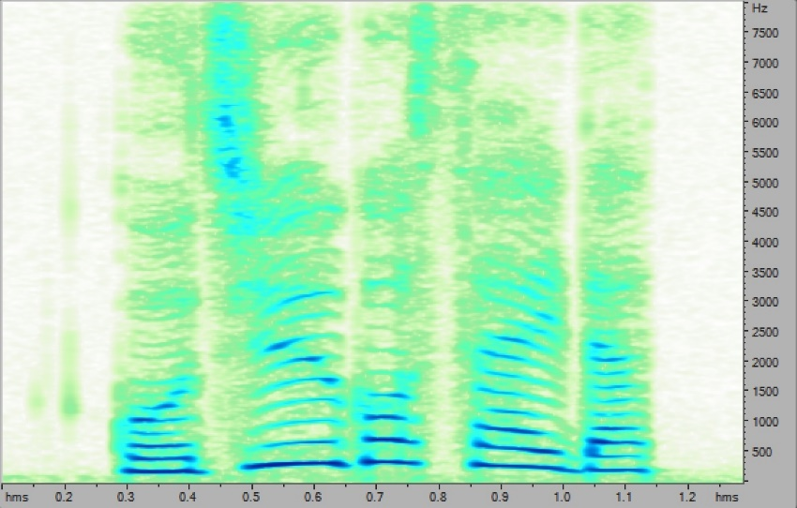
Quasi-periodic signal
Voiced speech (濁音)
  Vocal cords (聲帶) vibrate
  Fundamental frequency (F₀) and harmonics
  Periodic signal
  Vowel(母音), voiced consonant(有聲子音)
Unvoiced speech (清音):
  Vocal cords no vibration
  Non-periodic signal
  Unvoiced consonant(無聲子音)

Slide 6
Conventional speech synthesis
Vocoder: voice coder
Encoder (analyzer)
  decomposing speech into acoustic features
Decoder (synthesizer)
  synthesizing speech from acoustic features

Slide 7
Speech model
Source-filter model [R. McAulay+, 1986]
Mixed excitation
  Voiced excitation: “periodic pulse train (based on F₀)” mixed with “white noise”
  Aperiodicity: the ratio of pulse train and white noise
  Unvoiced excitation: “white noise”

Slide 8
Mixed excitation vocoder
STRAIGHT [H. Kawahara+, 1999]& WORLD [M. Morise+, 2016]
Encode speech into
  Spectral feature: spectral envelope (sp)
  Prosodic features: aperiodicity (ap) and f₀
Decode speech based on the acoustic features
Oversimplified assumptions of speech generation are imposed on the vocoders
Lost temporal details and phase information cause speech quality degradation

Slide 9
Neural-based generative model
Advanced modeling capability based on a deep and huge non-linear network
Directly modeling high temporal resolution audio signals without speech-specific assumptions
Autoregressive causal models
  Modeling the probability distribution of each sample based on the previous samples
  Conditional probability:
  RNN-based: SampleRNN [S. Mehri+, 2017]
  CNN-based: WaveNet [A. van den Oord+, 2016]

Slide 10
WaveNet
Audio signals have a very long term dependency
Basic RNN cannot model long-term correlations
Stacked CNN layers
  Input: a segment of previous samples (receptive field)
  Output: the conditional probability
  of the current sample

Slide 11
Dilated CNN [F. Yu+, 2016]
Convolution with skip holes
Efficiently extend the receptive field
Downsampling-like structure makes the network capture information on different levels

Slide 12
WaveNet Vocoder [A. Tamamori+, 2017]
WaveNet as a vocoder
  Input: acoustic features
  Output: speech waveform
Conditional WaveNet
  Conditional probability
  h: auxiliary features (conditional features)
  Acoustic features from conventional vocoder as the auxiliary features
  Without hand-craft assumption of speech generation
  Recover the lost phase and temporal details information

Slide 13
WaveNet Vocoder
Residual block
  Dilated CNN (DCNN)
  Gated structure
  Skip connection

Slide 14
Is WaveNet vocoder suitable for speech generation?
Speech signal is a quasi-periodic signal
  Periodic part: long-term correlation
  Non-periodic part: short-term correlation
WaveNet
  Fixed network architecture
  Without prior knowledge of speech signal
Problems of WaveNet as a vocoder
  Inefficient speech signal modeling
  Limited pitch controllability

Slide 15
Problem I:
Inefficient speech modeling
Modeling the very long-term dependency
  Long receptive field to cover the related samples
  huge network is required
Without the prior knowledge of audio periodicity
  Fixed network for both periodic and non-periodic parts
  Oversampling of periodic part
  Receptive field includes many redundant samples
  All samples have the same length of receptive filed is inefficient and unreasonable

Slide 16

Problem II:
Limited pitch controllability
WaveNet conditioned on unseen acoustic features
  F₀ is not observed in the range of training data
  Unseen feature pair of spectrum and F₀
    Original spectral feature with scaled F₀
  Difficult to generate speech
  Inaccurate pitch of the generated speech
  Normal (Natural):
  Normal (WaveNet):
  1.5 F₀ (Expected):
  1.5 F₀ (WaveNet):

Slide 17
Quasi-Periodic WaveNet [Y. -C. Wu+, 2019]
Pitch-dependent dilated convolution
  Inspired by code-excited-linear-prediction (CELP)
  Dynamically change the dilation size
  Model the periodic part with prior F₀ knowledge (long-term correlations)
Cascaded network
  Fixed modules model the non-periodic part with the nearest samples (short-term correlations)
  Adaptive modules for periodic part

Slide 18

Pitch filtering of CELP [M. Schroeder+, 1984]
CELP
  Pitch filtering (long-term correlations)
  Spectral filtering (short-term correlations)
Pitch filtering
  Model current sample with innovation input and related previous samples:
$$c_{o}\left[t\right]=G×c_{i}\left[t\right]+b×c_{o}\left[t−t_{d}\right]$$

Slide 19
Pitch-dependent dilated convolution
Fixed number of samples in a receptive filed
  Determined by the number of network layers
Effective receptive field can be changed with different dilation size
  Pitch-dependent
Dilated convolution:
Dilation size d
  Vanilla DCNN: time-invariant and constant
  Proposed PDCNN: time-variant and pitch-dependent

Slide 20
Pitch-dependent dilated convolution (cont.)
Pitch-dependent dilated factor: E_{t} = F_{s}/(F_{0,t} × a)

Slide 21
Dense factor
Dense factor a is the number of samples in one cycle period taken into account

Slide 22
Effective receptive filed
Fixed number of samples in a receptive filed
Fixed number of samples in one cycle
The same number of past cycles in a effective receptive field for arbitrary F₀

Slide 23
Cascaded networks
Fixed modules for short-term correlations
  Fixed dilated convolution (DCNN)
Adaptive modules for long-term correlations
  Pitch-dependent dilated convolution (PDCNN)

Slide 24
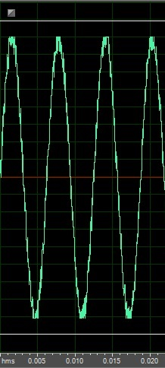
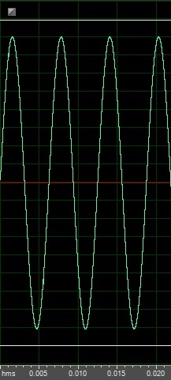
Sine wave generation
To evaluate the effectiveness of PDCNN for periodicity modeling
Sine wave generation
  Input: Noisy sine wave (SNR:20dB)
  and 1-dim noisy F₀
  Output: Clean sine wave
  Training
    4000 single-tone sine wave (1 sec / utts)
  Testing
    Initialize the receptive field with
    the noisy single-tone sine wave
    Noisy 1-dim F₀ as the auxiliary (conditional) feature (1 sec)
Input
Output

Slide 25
Experiments setting
Training
  80~400 Hz sine waves (step size: 20Hz)
Testing
  Under 1/2 L: 10–40 Hz (step size: 10Hz)
  Above 1/2 L: 50–70 Hz (step size: 10Hz)
  Inside: 80, 90, 100, 200, 300, 400 Hz
  Under 3/2 U: 450–600 Hz (step size: 50 Hz)
  Above 3/2 U: 650–800 Hz (step size: 50 Hz)

Slide 26
Experiments setting
Objective measurement
  SNR
  RMSE of log F₀
Models
  pQPNet: all adaptive modules
  QPNet: fixed-adaptive modules
  rQPNet: adaptive-fixed modules
  WNf: full-size WaveNet
  WNc: compact-size WaveNet

Slide 27
Model comparison
Hyper-parameter | WNf | WNc | (r)QPNet | pQPNet
Number of fixed layer | 10 | 4 | 4 | -
Number of fixed repeat | 3 | 4 | 3 | -
Number of adaptive layer | - | - | 4 | 4
Number of adaptive repeat | - | - | 1 | 4
Constant a | - | - | 8
Causal and dilated CNN | 128 channels
1×1 CNN in residual block | 128 channels
1×1 CNN between skip-connection and softmax | 64 channels
Number of parameters (×10⁶) | 2.8 | 1.5 | 1.5 | 1.5

Slide 28
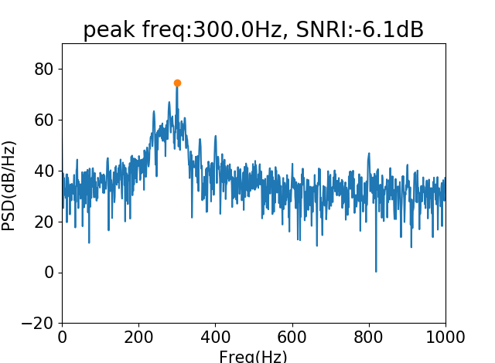
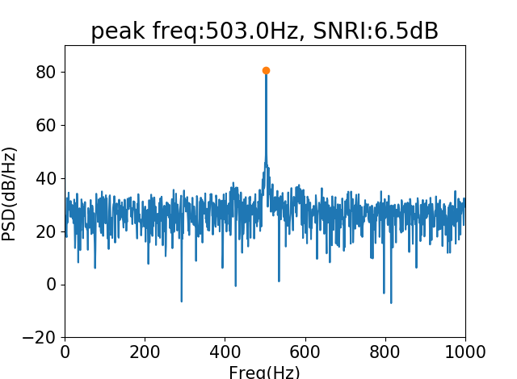
Peak frequency extraction
Power spectrum density
Auxiliary feature: 500Hz (unseen)
WNf
pQPNet

Slide 29
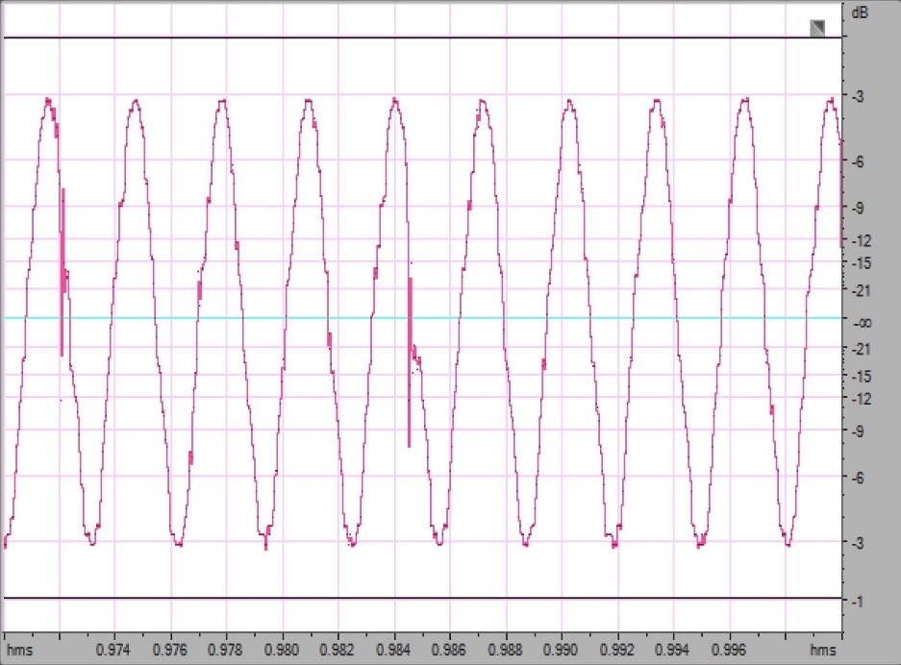
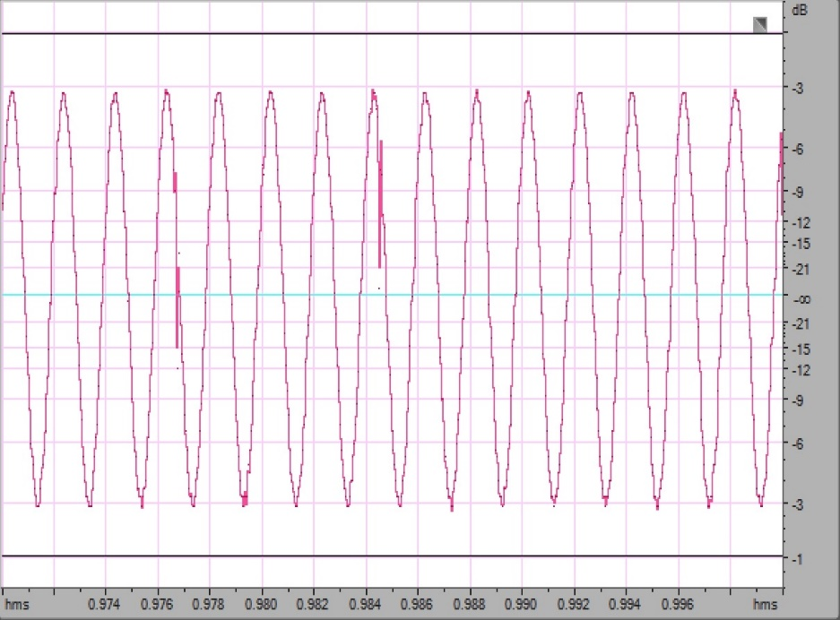
Output single-tone sine wave
Auxiliary feature: 500Hz (unseen)
WNf
pQPNet

Slide 30
Dense factor comparison
pQPNet with dense factor 1, 2, 4, 8, 16, 32, 64
Dense factor 1 and 2 are unstable
Dense factor 32 and 64 easily degenerate PDCNN into DCNN in the high F₀ cases
We set dense factor 8 for the balance of speech quality and pitch-accuracy

Slide 31
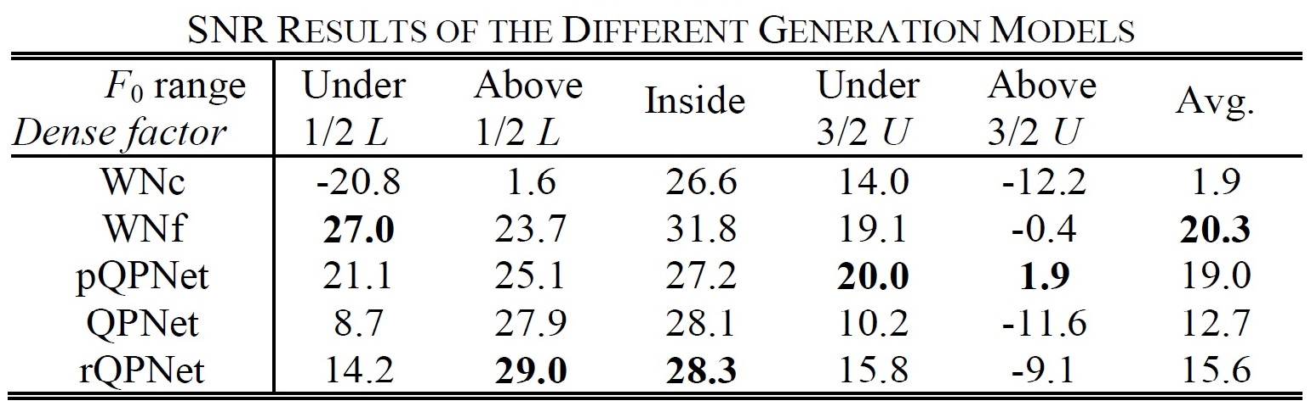
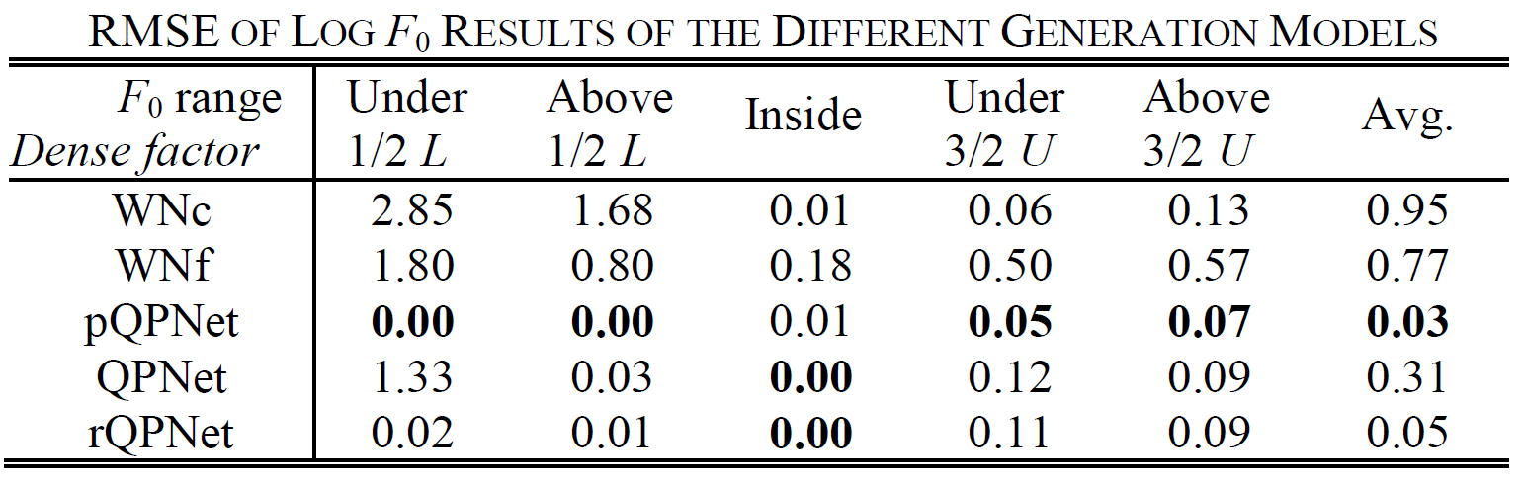
Model comparison
PDCNN significantly improve the capability of periodicity modeling

Slide 32
Experiments setting
Corpus for WaveNet-based vocoder
  VCC2018 and patrial CMU ARCTIC
  Training (VCC2018): 81 sentences * 12 speakers
  Training (ARCTIC): 1034 utterances * 2 speakers
  Testing (SPOKE set): 35 utterances / speaker
Models
  QPNet / rQPNet with cont./ disc. E_{t}
  WNf / WNc
  Full QPNet/ rQPNet (WNf with 4 etra adaptive layers)
  WORLD

Slide 33
Model comparison
Hyper-parameter | WNf | WNc | QPNet | Full QPNet
Number of fixed layer | 10 | 4 | 4 | 10
Number of fixed repeat | 3 | 4 | 3 | 3
Number of adaptive layer | - | - | 4 | 4
Number of adaptive repeat | - | - | 1 | 1
Constant a | - | - | 8
Causal and dilated CNN | 512 channels
1×1 CNN in residual block | 512 channels
1×1 CNN between skip-connection and softmax | 256 channels
Number of parameters (×10⁶) | 44 | 24 | 24 | 50

Slide 34
Experiments setting
Sampling rate: 22.05kHz
Acoustic features (extracted using WORLD)
  34-dim mel-cepstral coefficients (mcep)
  2-dim coded aperiodic features
  1-dim interpolated continuous F0
  1-dim voice/unvoice binary flag
Scaled F₀
  Ratio: unchanged, 1/2, 3/4, 5/4, 3/2, 2
MCD, RMSE of log F₀, U/V detection error

Slide 35
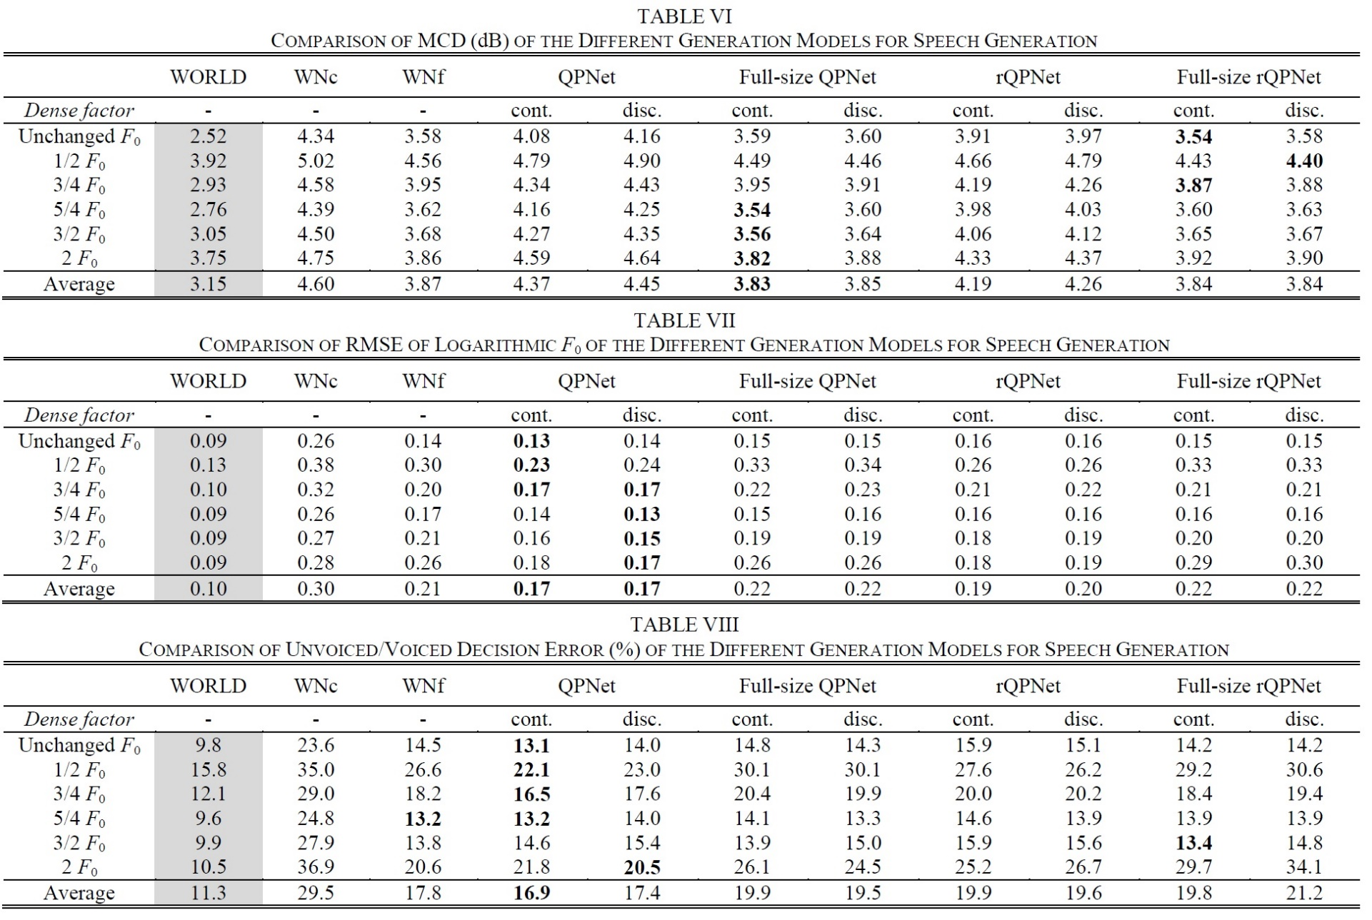
Objective evaluation

Slide 36
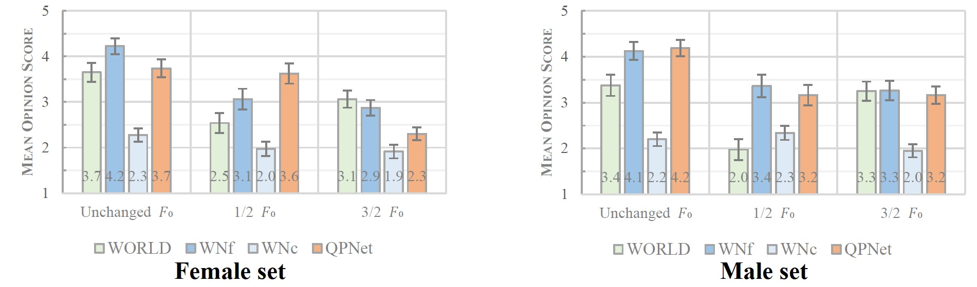
Subjective evaluation
MOS for speech quality

Slide 37
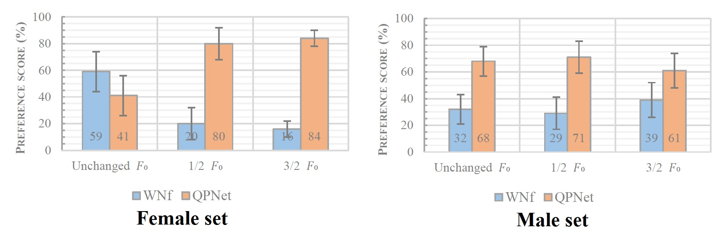
Subjective evaluation
XAB preference test for pitch accuracy

Slide 38
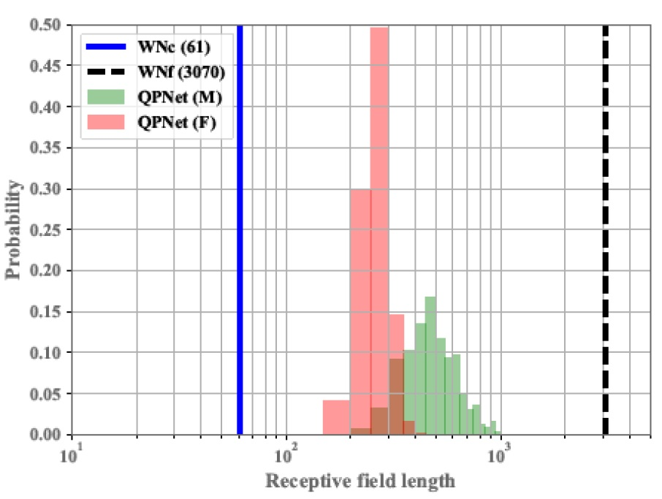
Effective receptive field length
WNf > QPNet(male set) > QPNet(female set) > WNc

Slide 39
Demo
Condition on unchanged F₀
 | Female | Male
Natural
WORLD
WNf
WNc
QPNet
rQPNet
Full QPNet
Full rQPNet

Slide 40
Demo
Condition on 1/2 F₀
 | Female | Male
Natural | - | -
WORLD
WNf
WNc
QPNet
rQPNet
Full QPNet
Full rQPNet

Slide 41
Demo
Condition on 3/2 F₀
 | Female | Male
Natural | - | -
WORLD
WNf
WNc
QPNet
rQPNet
Full QPNet
Full rQPNet

Slide 42
Conclusion
PDCNN efficiently extends the effective receptive filed and reduces the network size requirement.
Cascaded structure simultaneously models long- and short-term correlation well.
Pitch controllability
  QPNet significantly outperforms WNf and WNc
Speech quality
  QPNet outperforms same-sized WN (WNc)
  QPNet is comparable with double-sized WN (WNf)

Slide 43
Thank you for your attention ! https://bigpon.github.io/QuasiPeriodicWaveNet_demo/

